Slide 1
SHORT TERM STOCK MARKET PREDICTION USING MACHINE LEARNING
Presented By:
SUPRIYO MANDAL(18701620035)
SHOVAN MAJI (18700220041)
SACHIN PAUL (18700220047)
MAITRYEE DEY (18700221136)

Slide 2
01
INTRODUCTION
What is it?
Time series forecasting predicts future stock prices, helping investors make better decisions and trades.
Our Approach:
We use an advanced prediction system with sliding-window optimization to improve accuracy.
Why It Matters:
Our model can handle complex, non-linear patterns in stock data, outperforming traditional methods. This makes it a valuable tool for predicting financial markets.

Slide 3
—TOM MITCHELL
WHAT IS MACHINE LEARNING ?
“Machine Learning is the study of algorithms that
- improve their performance P
- at some task T
- with experience E “

Slide 4
EXISTING TRADITIONAL METHODS
SUPPORT VECTOR REGRESSION
RIDGE REGRESSION
RANDOM FOREST
Computes regression line between dependent variable and independent features
Combines multiple decision trees to improve accuracy by averaging their predictions and taking the majority vote.
Finds a function that best predicts the continuous output value for a given input value.
DECISION TREE
Decision learning is a machine learning technique where models make decisions based on input data to predict outcomes.
K NEAREST NEIGHBOR
ARTIFICIAL NEURAL NEURON
Predicts the classification of a new data point by comparing it to the K most similar data points in the training data.
Consists of interconnected nodes that process information to make predictions or decisions.

Slide 5

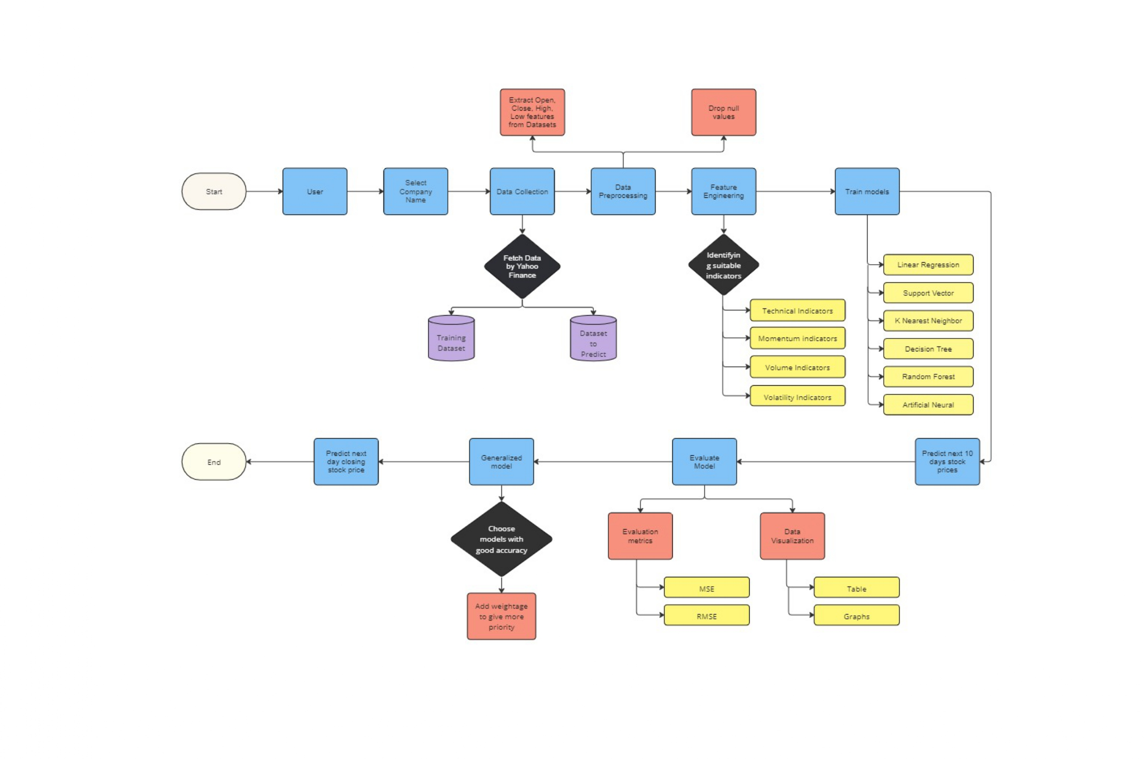
ARCHITECTURE

Slide 6
OPTIMIZING TRAINING DATA SIZE
OBJECTIVE
The objective is to determine the optimal week for training machine learning models on stock market data, we need to evaluate the performance of various models on datasets spanning different weeks.
We analyzed data of five companies by training 1 week, 2 weeks, 3 weeks, 4 weeks to all algorithms.
OBSERVATION
Reliance Industries:
Best Week: 1 week and 4 weeks
SBI Bank:
Best Week: 4 weeks
Bajaj Finance:
Best Week: Week 1
HDFC Bank:
Best Week: Week 4

Slide 7
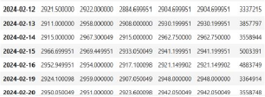
Week 1 :
Week 2:
Week 4 :
Week 3 :

Slide 8
Actual and Predicted Graph
Week 2 :
Week 1 :
Week 3 :
Week 4 :

Slide 9
EVALUATION METRICS:
WEEK 1
WEEK 2
WEEK 3
WEEK 4

Slide 10
APPROACH SELECTION
SLIDING WINDOW APPROACH
TIME SERIES FORCASTING
Involves analyzing historical stock price data to make predictions about future prices.
It involves looping through each prediction day, training the model, predicting the next day's closing price, including this day's closing data in the training set, removing the oldest data, and retraining the model.

Slide 11
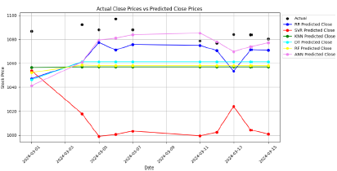
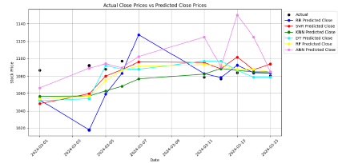
ICICI BANK
ACTUAL VS PREDICTED PRICES
TIME SERIES FORECASTING
SLIDING WINDOW

Slide 12
FEATURE ENGINEERING
TECHNICAL INDICATOR
MOMENTUM INDICATOR
VOLATILITY INDICATOR
VOLUME INDICATOR

Slide 13
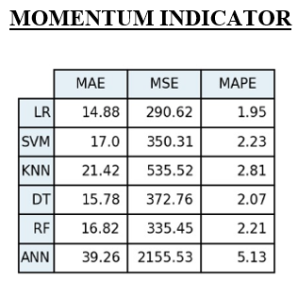
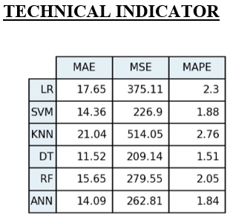
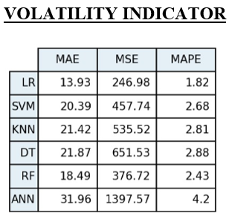
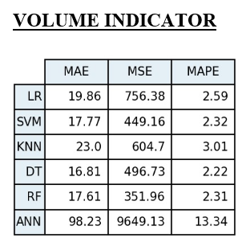
EVALUATION METRICS
MOMENTUM INDICATOR
TECHNICAL INDICATOR
VOLATILITY INDICATOR
VOLUME INDICATOR

Slide 14
ALGORITHMS SELECTION
01
02
CONSLUSION DERIVED
ACTUAL VS PREDICTED PRICES
Increasing order of accuracies based on companies –
Companies with high volatilities :
RR > DT > RF
Companies with Low volatilities :
RF > DT > RR

Slide 15
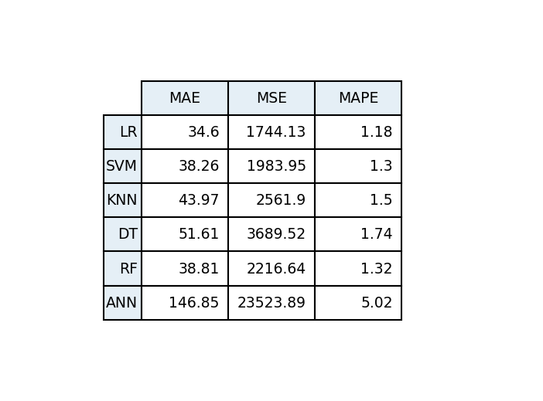
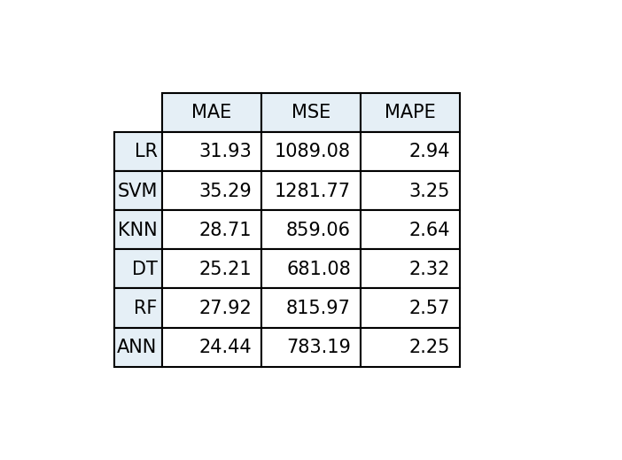
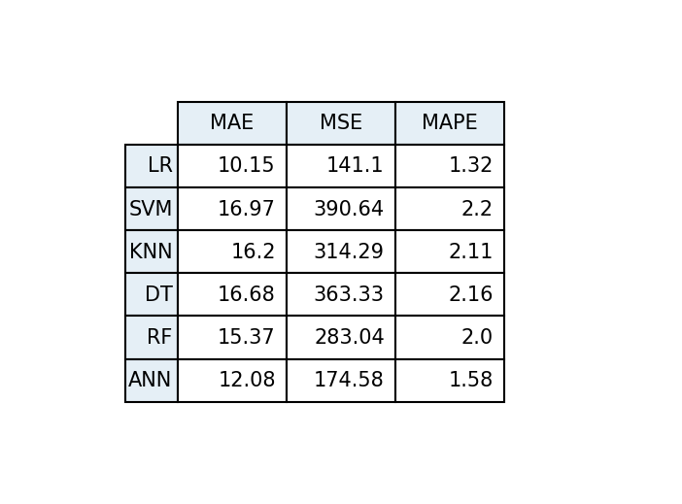

EVALUATION METRICS:
RELIANCE INDUSTRIES
ICICI BANK
Good Accuracy
models
Good Accuracy
models
LR
SVM
RF
ANN
DT
RF
HDFC BANK
BAJAJ FINANCE
Good Accuracy
models
Good Accuracy
models
LR
DT
RF
LR
SVM
RF

Slide 16
OUR PROPOSED MODEL
CONCLUSION DERIVED
Variables | Possibilities | Conclusion
Training Data | 1 ,2,3,4 weeks | 1 week for high fluctuations 4 weeks for trends showing
Approach | Time Series Forecasting Sliding Window | Sliding Window
Feature Engineering | Technical, Momentum, Volatility, Volume | Technical
Algorithms | RR, SVR, KVM, DT, RF, ANN | RR, DT, RF

Slide 17
WEIGHTING STRATEGY
To illustrate the weighted averaging process, consider the following example. Suppose we have the following predictions for a stock price:
HIGH VOLATILITY DATASETS
LOW VOLATILITY DATASETS
RF,DT,RR predicts 100, 105, 60 respectively
We assigned the following weights:
w(RF) = 0.5 , w(DT) = 0.3 ,w(RR) = 0.1
To combine these predictions, we calculate the weighted average as follows:
Weighted Prediction = (0.6×100)+(0.3×105)+(0.1×60)
Weighted Prediction=50+42+6
Weighted Prediction of our Proposed Model =98
RF, DT, RR predicts 60, 80, 100 respectively
We assigned the following weights:
w(RF) = 0.1 , w(DT) = 0.3 ,w(RR) = 0.6
To combine these predictions, we calculate the weighted average as follows:
Weighted Prediction = (0.1×60)+(0.3×80)+(0.6×100)
Weighted Prediction of our Proposed Model =90

Slide 18
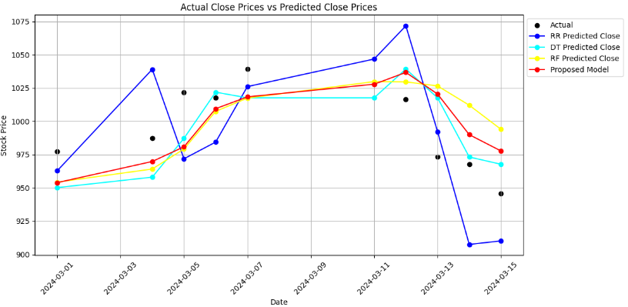
PROPOSED MODEL VS EXISTING METHODS
TATA MOTORS

Slide 19
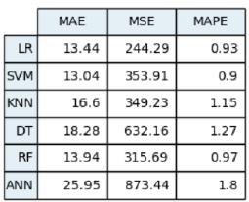
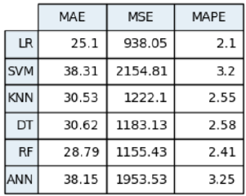
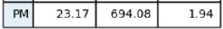
EVALUATION METRICS:
TATA MOTORS
BAJAJ FINANCE
HDFC BANK
BHARATI AIRTEL

Slide 20
FUTURE SCOPE
In the future, we aim to enhance our stock market prediction model by extending its capabilities to include mid-term and long-term forecasts. This will involve developing advanced algorithms to analyze broader time frames, incorporating more comprehensive datasets, and improving accuracy through continuous learning and refinement.
CONCLUSION
our project successfully developed a model for short-term stock market prediction, demonstrating significant accuracy and reliability. This model serves as a valuable tool for traders and investors seeking to make informed decisions in the short term. Future work will focus on extending these capabilities to mid-term and long-term predictions for broader applicability.

Slide 21
HOPE OF YOU LIKE OUR PRESENTATION !!
Thank You!

